Slide 1

SC1015
Mini Project:
B125 - Group 7
Presented by: Choo Wei Boon
Wong Kang Yi, Rhyan
Truong Thi Hai Yen

Slide 2
Table of Content
Dataset and Motivation
Exploratory Data Analysis
Model Comparison
Core Analysis
Conclusion

Slide 3
1
Dataset
and
Motivation

Slide 4


Dataset
Time Series
Dataset: Tetuan City
power consumption

Slide 5
Motivation
Background of Tétouan City:
Reliance on imported energy
Increasing population size
Importance of energy consumption forecast:
Reduce production costs
Avoid power shortages
Ensure energy demands are met

Slide 6
Motivation
Problem Definitions:
Which of the models implemented will be better at predicting the energy consumption?
Are we able to predict the energy consumption based on a given week?
XGBoost, LSTM and Random Forest
Accuracy metrics: RMSE and MAPE

Slide 7
2
Exploratory Data
Analysis

Slide 8
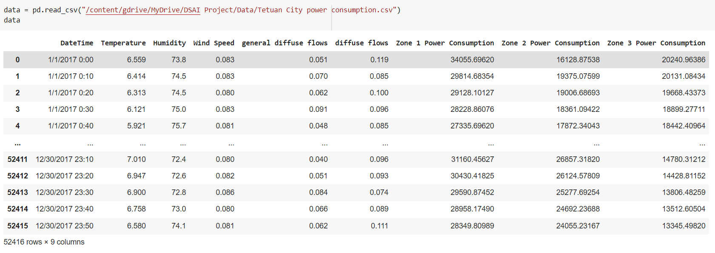
Visualisation of dataset

Slide 9
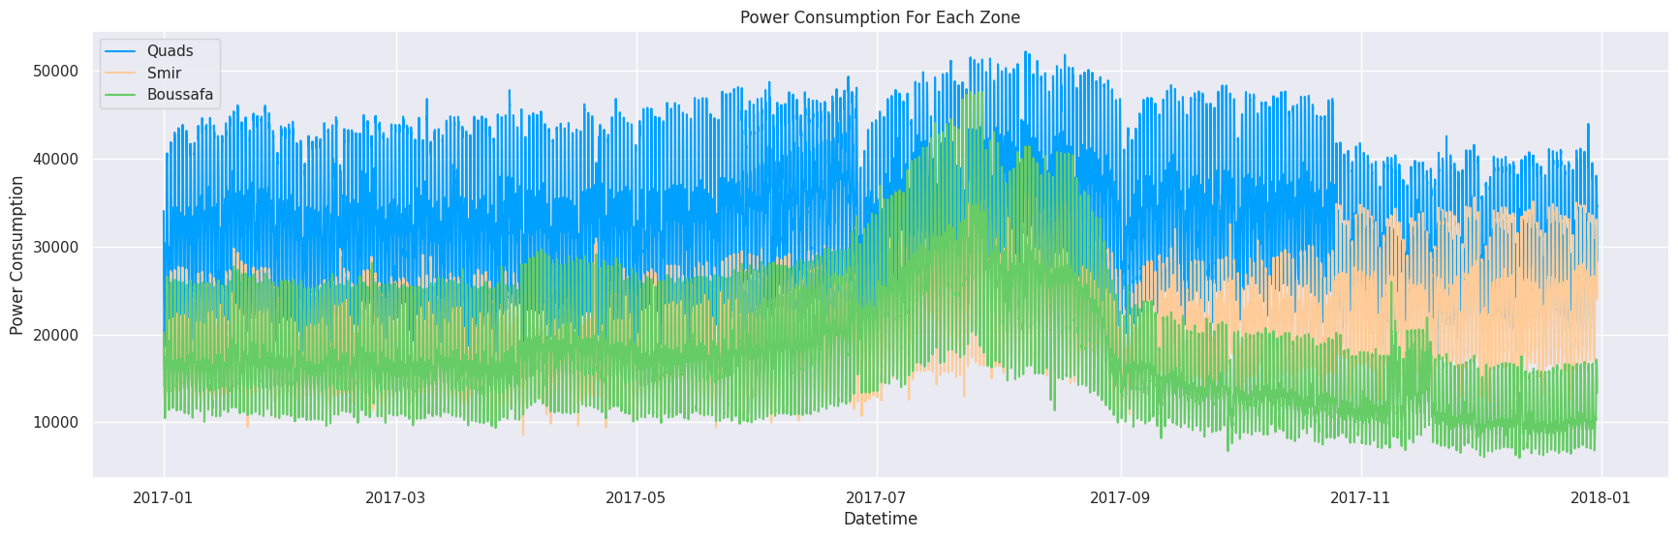
Visualisation of dataset
(insert plot for entire dataset, total power consumption vs datetime)

Slide 10
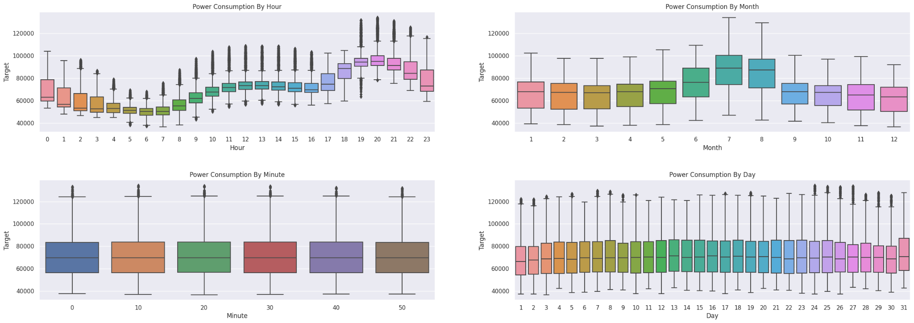
Visualisation of dataset

Slide 11
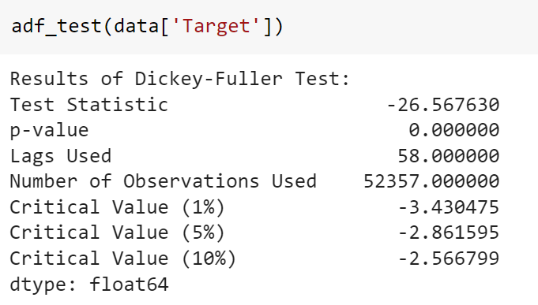
Stationary Test
p-value < 0.05
Data is stationary

Slide 12
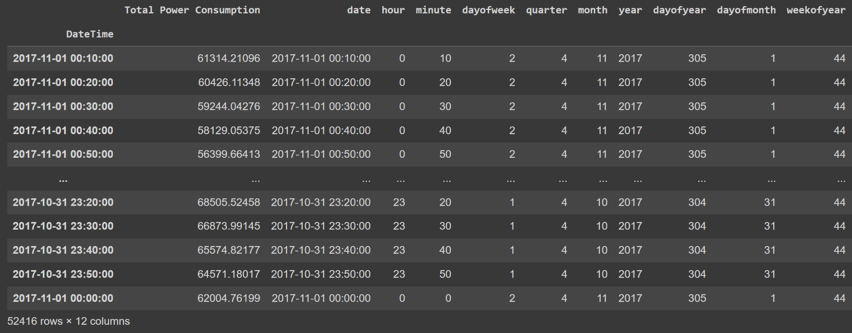
Data Cleaning & Preparation (XGBoost & Random Forest)
1. Merge zones into one feature
2. Remove other features
3. Split ‘DateTime’ into features

Slide 13
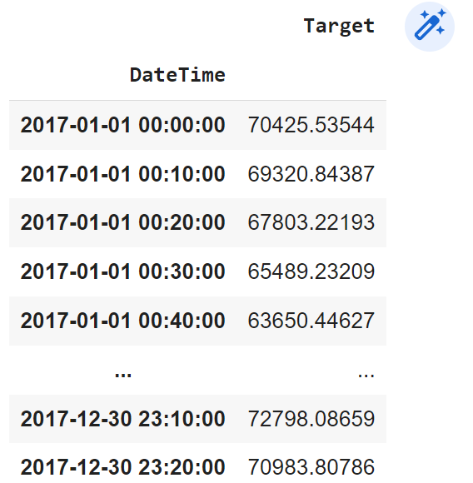
Data Cleaning & Preparation (LSTM)
1. Merge zones into one feature
2. Remove all other features
3. Check for missing data

Slide 14
3
Model Comparison

Slide 15
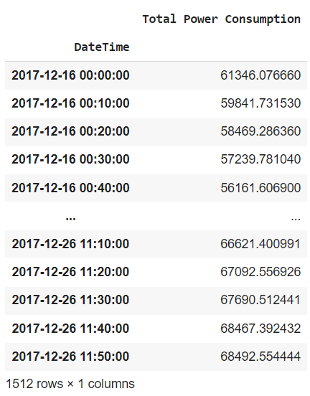
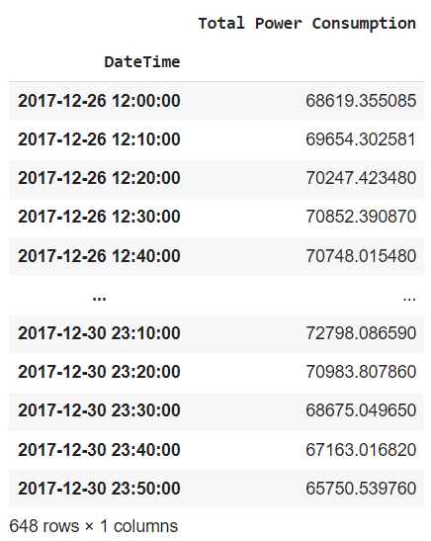
Splitting train, test
Picked last 15 days
Split into train and test
Split ratio (70:30)
data_train
data_test

Slide 16
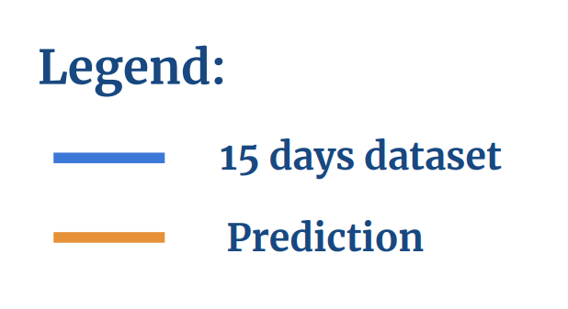
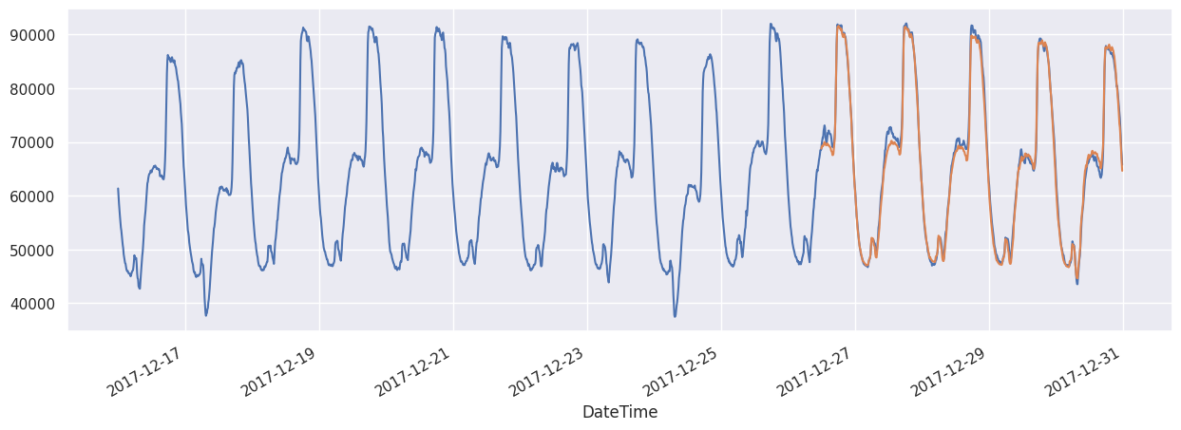
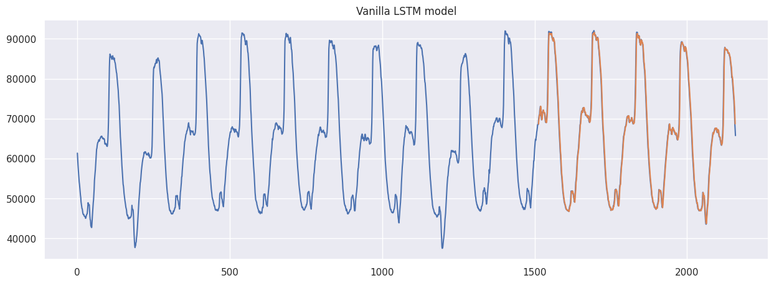
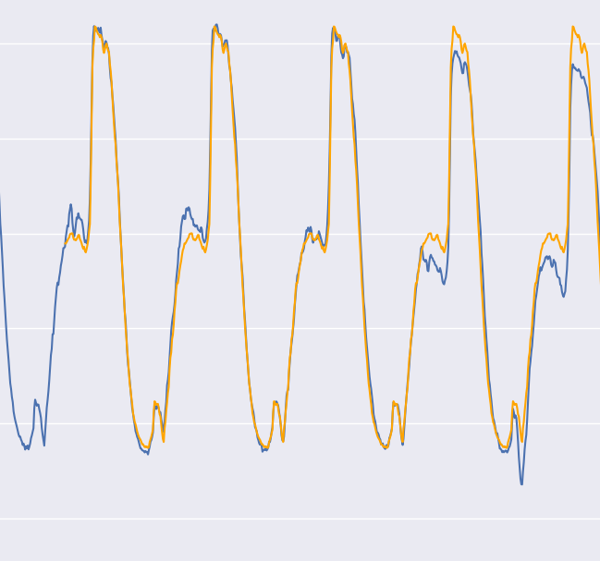
Prediction results for 15 days
XGBoost
model
LSTM
model
Random Forest
model

Slide 17
Accuracy Metrics (15 days)
Accuracy
Metrics
 | RMSE | MAPE
XGBoost | 1163.66 | 1.3604
LSTM | 1157.74 | 1.1772
Random Forest | 1827.26 | 2.0137
Model
2
1
3

Slide 18
Rationale For Model Chosen
Most ideal Model
Good accuracy, more straightforward
XGBoost
LSTM
Best accuracy, but more complex
Random Forest
Lowest accuracy metrics in comparison
Least ideal model

Slide 19
4
Core Analysis

Slide 20
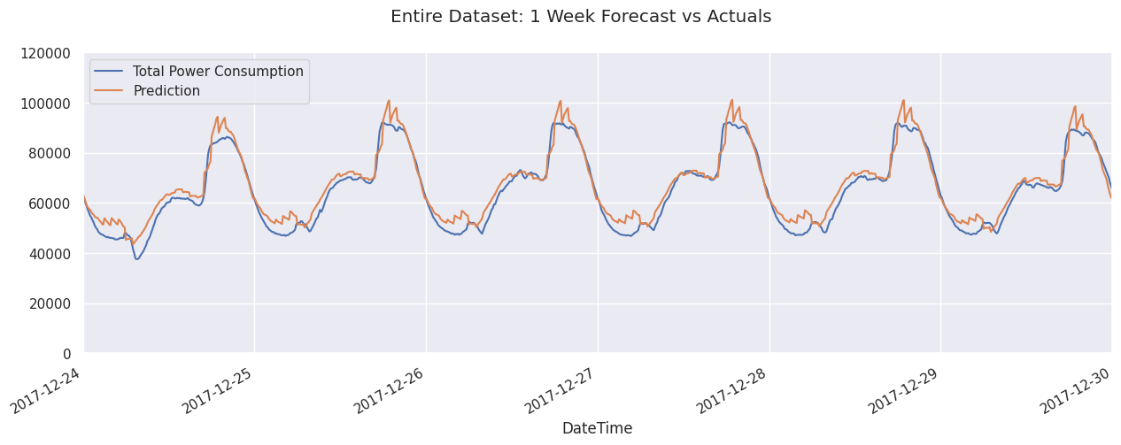
Insert snapshot of entire dataset (plot)
Prediction results from chosen model (XGBoost) - entire dataset

Slide 21
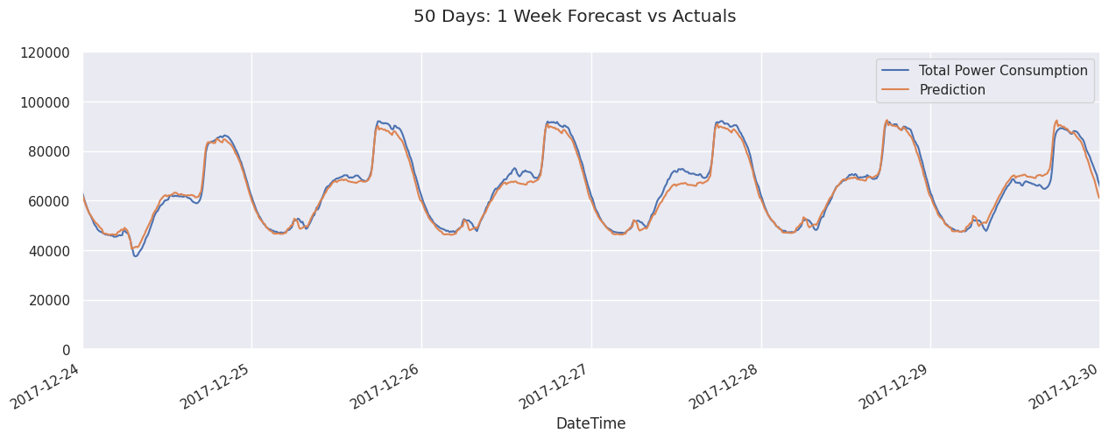
Insert snapshot of entire dataset (plot)
Prediction results from chosen model (XGBoost) - 50 days dataset

Slide 22
Accuracy Metrics (XGBoost)
Accuracy
Metrics
 | RMSE | MAPE
Entire dataset | 4491.2091 | 6.1412
50 days | 1831.7407 | 2.2841
15 days | 1163.66 | 1.3604
Model

Slide 23
Time series forecasting
Random Forest Model
LSTM Model
XGBoost Model
Predicting with sequential data vs data features
Not suitable for time series problem
Requires normalising the data, vanilla and stacked variation
Flexible model, can be implemented in either ways
Notes:
Lessons learnt…

Slide 24
5
Conclusion

Slide 25
Outcome of Mini Project
Which of the models implemented will be better at predicting the energy consumption?
Are we able to predict the energy consumption based on a given week?
LSTM is more accurate, but we still chose XGBoost.
Yes, using able to predict with data from 50 days ahead.

Slide 26
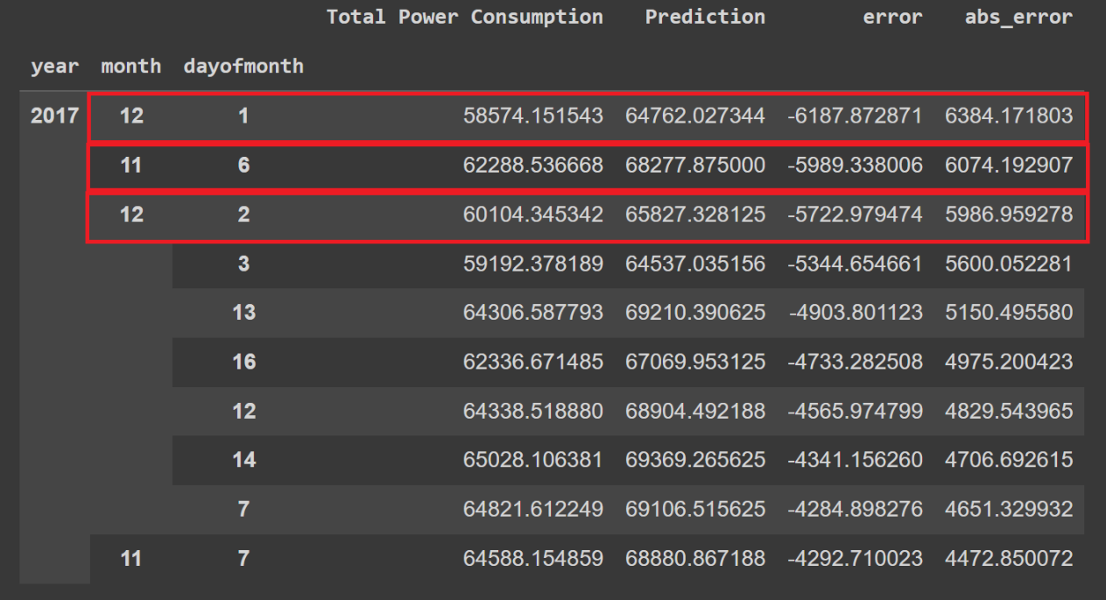
Data-Driven Insights
Recommendations
Holiday Spike:
Prophet’s Birthday (1 & 2 Dec)
Green March Day (6 Nov)
Holidays in next 50 days:
-> anticipate potential spike
-> increase energy production (according to prediction)

Slide 27
The End
Thank you for your kind attention

